Slide 1

Event-driven data procesiranje sa KEDA frameworkom, Azure funkcijama i Kubernetesom
Ratomir Vukadin, MCT, Azure Developer, Azure Data Engineer

Slide 2

Text prezentacije je ispisan u fontu RUBIK, boja R:40 G:40 B:40.
Veličina fonta striktno 18 pt (bez varijacija).
Sadržaj prezentacije mora biti koncizan, ilustrativan, bez previše tekstualnog sadržaja.
Maksimalan broj riječi po slide-u je 6x6 (6 alinea x 6 riječi).
Prored između redova je 2.0.
Veličina text box-a je W: 28,7 H: 11,48
NASLOV SLIDEA POSTAVITI OVDJE, BIJELA BOJA, MAX 18 pt

Slide 3
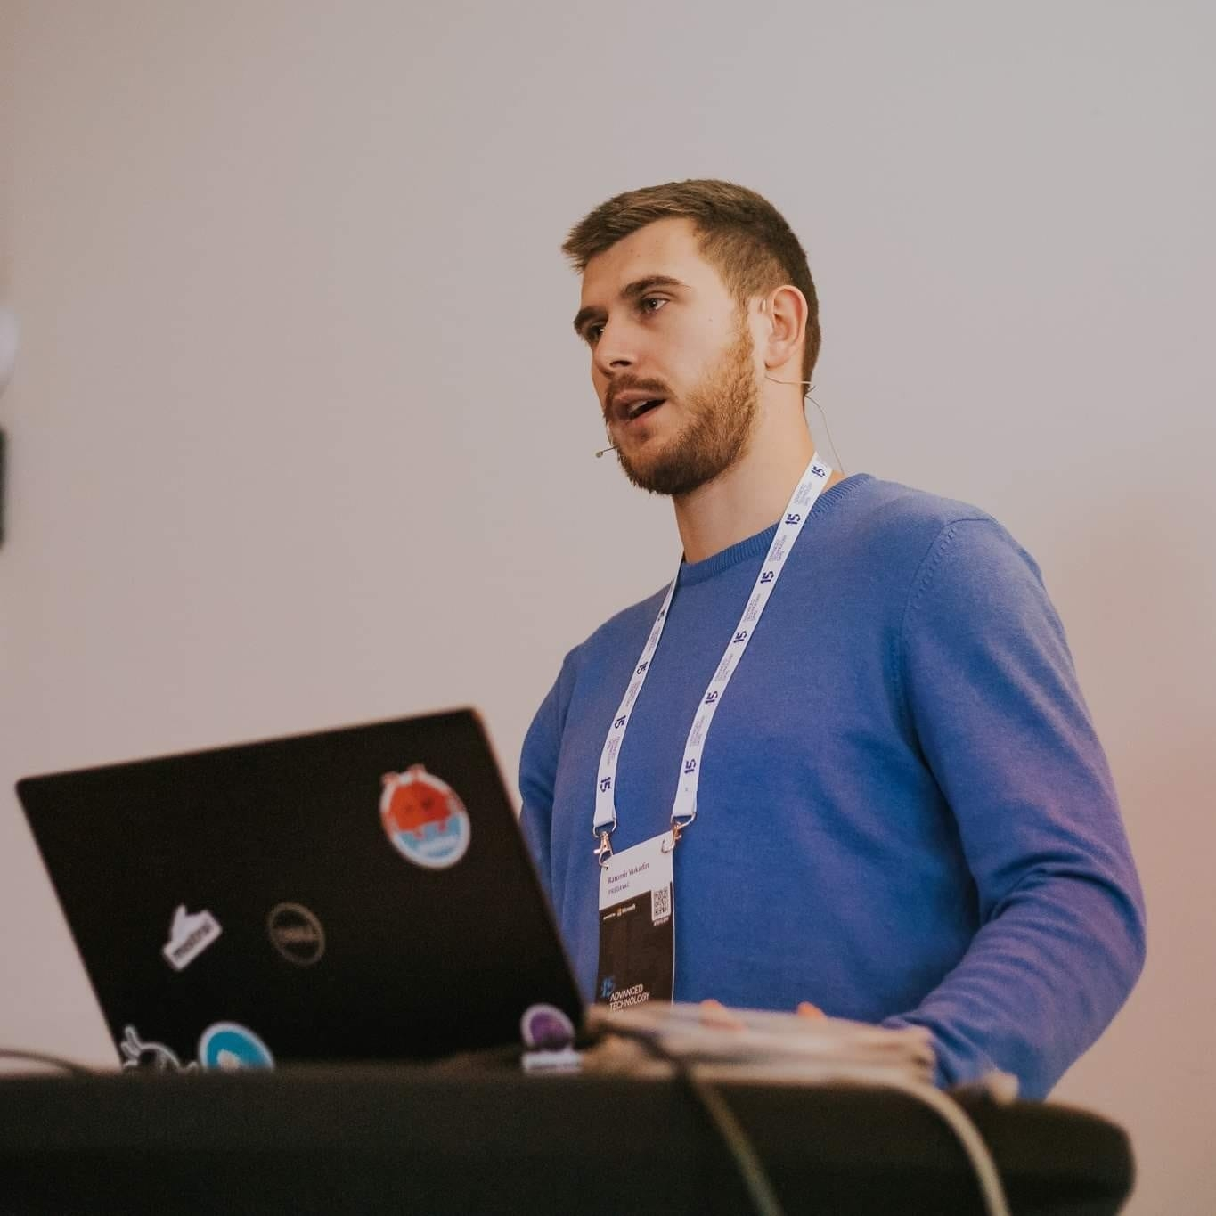
https://www.linkedin.com/in/ratomir-vukadin-rvs/
https://twitter.com/Ratko_V
https://github.com/Ratomir
https://www.ratomirvukadin.com
Network 9, WinDays19, Azure Bootcamp, Tarabica19, Sinergija19, MS Community 8, ATD15…
Ratomir Vukadin
DevOps Engineer – Mistral www.mistral.ba

Slide 4
Agenda
Azure functions
Azure functions on Docker containers
Kubernetes - HPA
KEDA
Demo – AKS – Queue – Power BI

Slide 5
KEDA – Azure Functions V1 Event Driven Data Processing with KEDA Framework, Azure Functions and Kubernetes – YouTube
KEDA – V2 – 16. September 2020

Slide 6
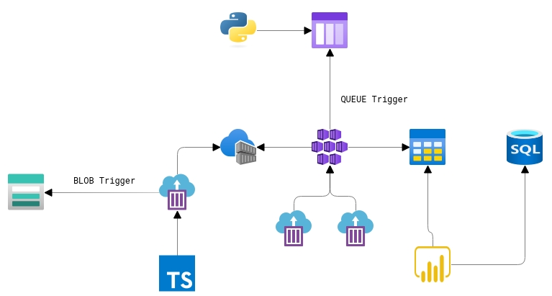

Slide 7

Azure functions from other perspective
Serverless is about building event-based applications on a function by function basis without worrying about traditional “servers”.
Azure Functions can easily be hosted in different environments
Open sourced
Docker image
Azure Container Instance/Fargate
https://github.com/Azure/azure-functions-host

Slide 8

.NET Core, Java, Python (3.X), Node, PowerShell (Core)
Docker
Docker Registry (Docker Hub, ACR, ECR, …)
Kubernetes cluster (AKS, Minikube, GCP… )
Functions Core Tools 2.0 (Azure Functions CLI) - https://github.com/Azure/azure-functions-core-tools
Visual Studio Code/Visual Studio + Visual Studio Code extension
What we need?

Slide 9
Horizontal Pod Autoscaler
The Horizontal Pod Autoscaler automatically scale the number of pods in a replication controller, deployment or replica set based on observed CPU utilization or custom metrics

Slide 10
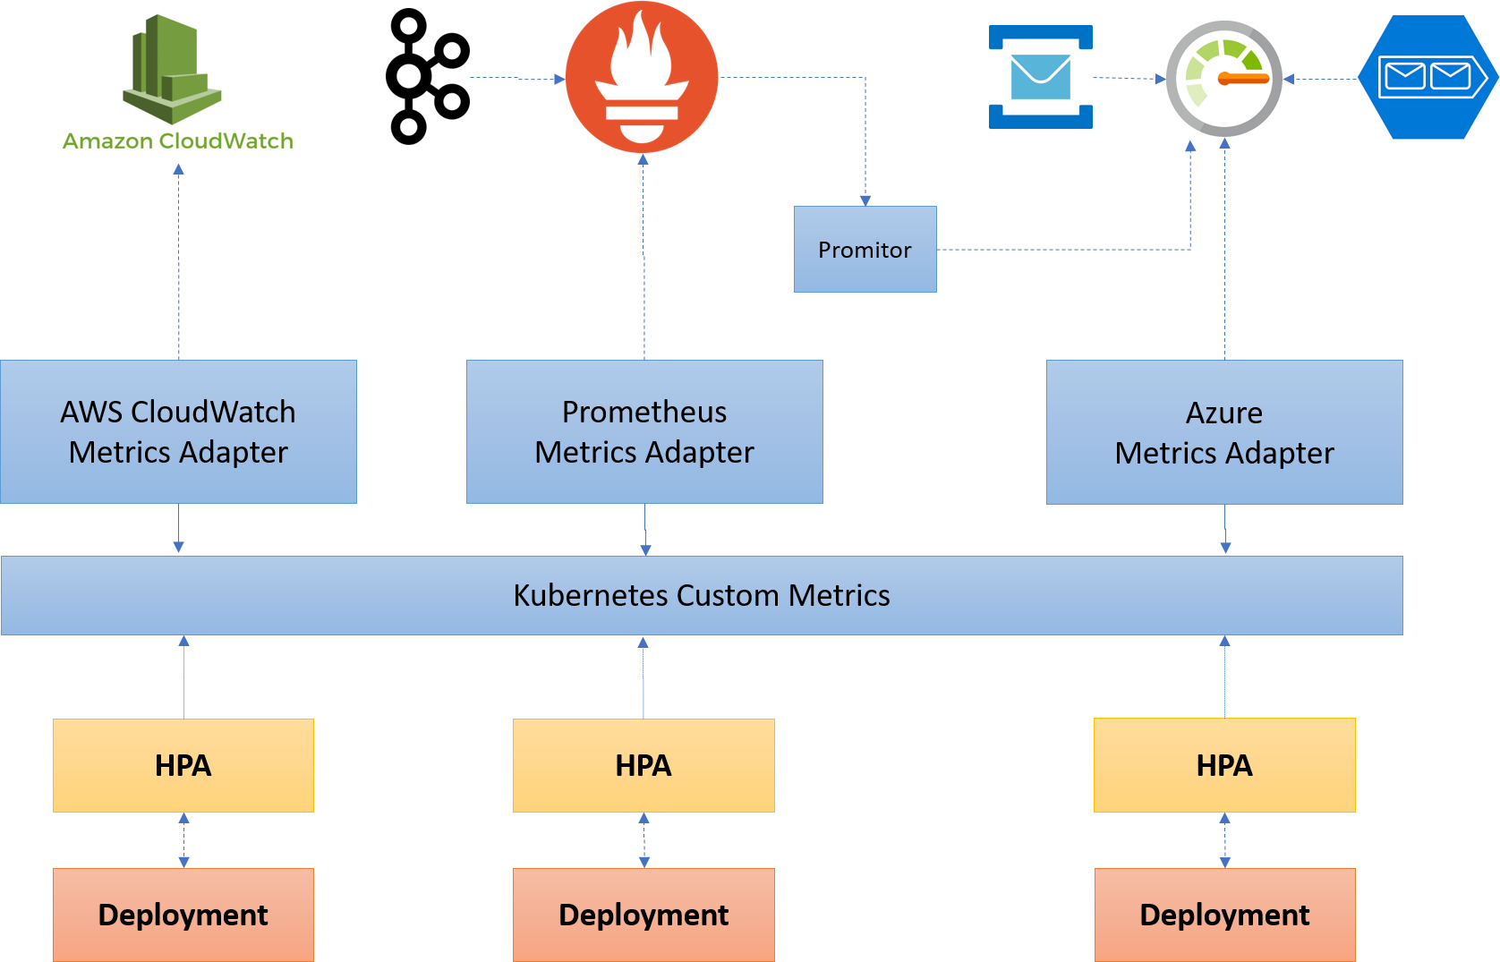

Slide 11

KEDA Kubernetes-Event-Driven-Autoscaling
Monitors the rate of events to proactively scale any container
Feeds the data into the Kubernetes system to drive scaling
KEDA can run on both, any cloud, any Kubernetes, integrates natively HPA
Open source (MIT License) and onboarding to CNCF
Extensible and pluggable scalers to grab metrics from any event source
https://github.com/kedacore
https://keda.sh/

Slide 12
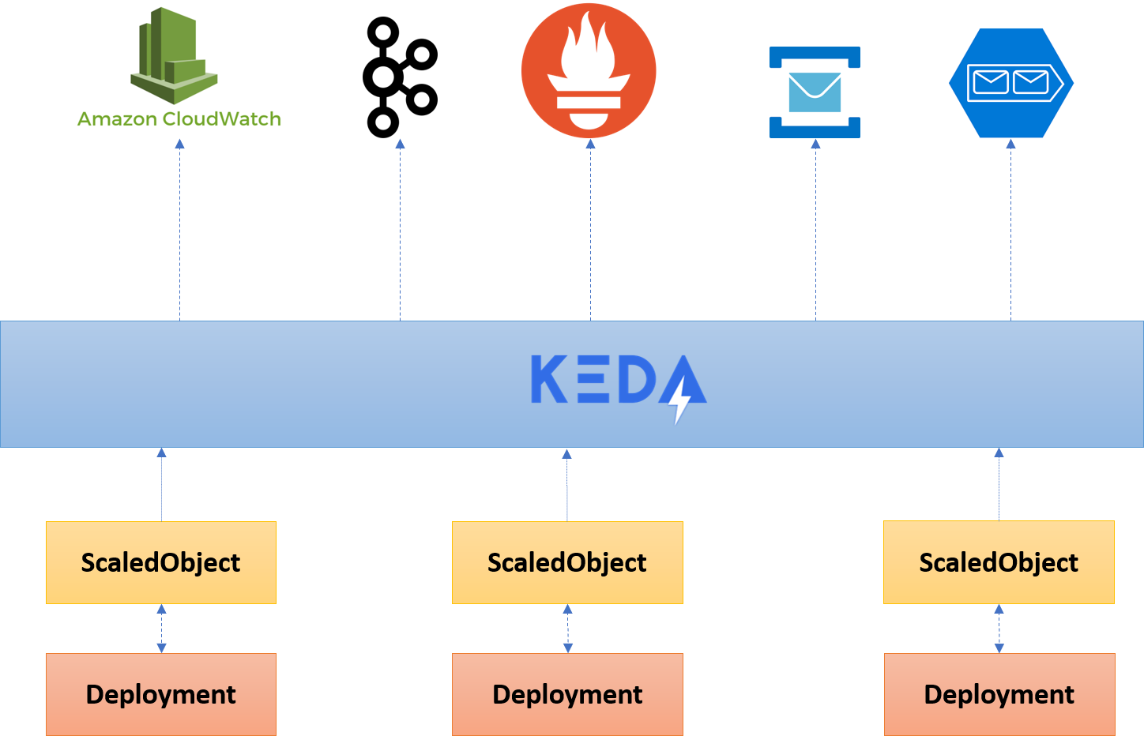

Slide 14
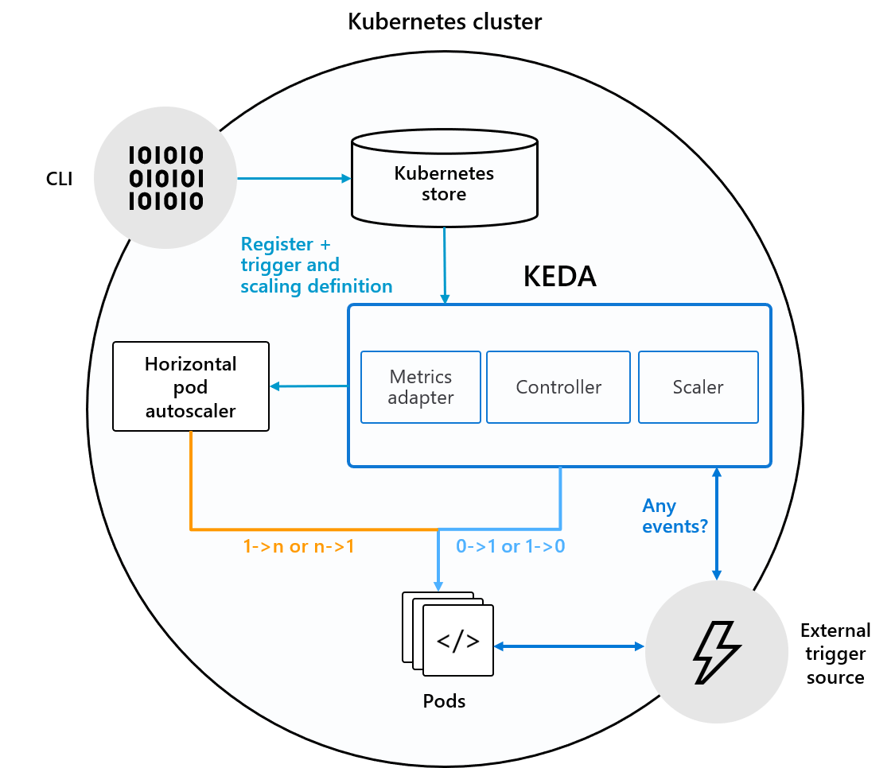
How KEDA works
Agent, activate deactivate a deployment to scale, or to zero on no events
As HPA, expose rich event data, like queue length or stream to HPA to drive scale up or out

Slide 15
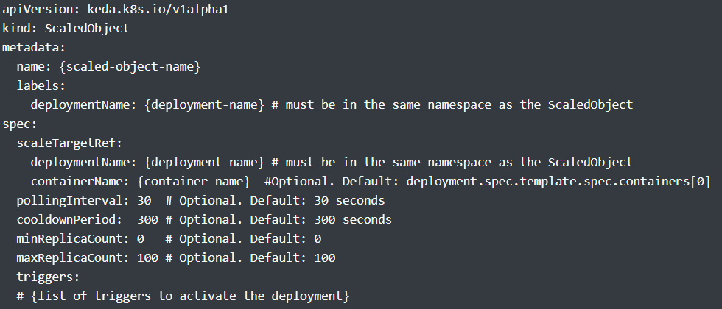
The magic – Keda V1

Slide 16
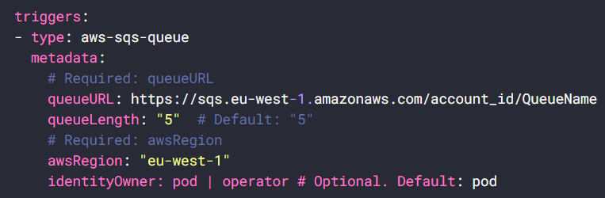
AWS SQS Queue - KEDA | AWS SQS Queue

Slide 17
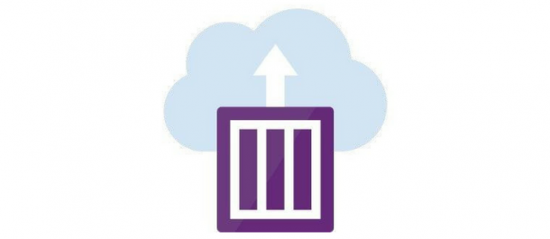
Run containers on serverless Azure Container Instances
You can flag any deployment as
Run ONLY on Virtual Nodes
Run on a mix of Virtual and Dedicated Nodes
Never run on Virtual Nodes
Fantastic for bursts of traffic
Integrates seamlessly with Azure Functions and KEDA
Virtual nodes

Slide 18
Apache Kafka Topic
AWS SQS Queue
Azure Service Bus
Huawei Cloudeye
NATS Streaming
RabbitMQ Queue
AWS CloudWatch
Event sources
Apache Event Hub
Azure Storage Queue
Google Cloud Pub/Sub
Prometheus
Redis Lists

Slide 19
func kubernetes install --namespace keda
mkdir sample-queue
cd sample-queue
func init . –docker
func new
docker build –t myregisty.registry.com/demo:v1
func kubernetes deploy --name name-deploy --registry myregisty.registry.com/remo:v1

Slide 20

HVALA NA PAŽNJI!

